Slide 1

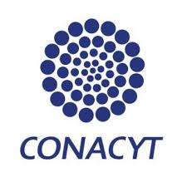
Fabrication of graphitic-carbon suspended nanowires through mechano-electrospinning of photocrosslinkable polymers
Osamu Katagiri-Tanaka A01212611@itesm.mx
Principal Advisor: Dr. Héctor Alán Aguirre Soto Co-advisor and Director of Program: Dra. Dora Iliana Medina Medina
15 May 2020

Slide 2
Agenda
<a point for discussion> : <5min
<another point for discussion> : ~20min

Slide 3
Motivation & Problem Statement

Slide 4
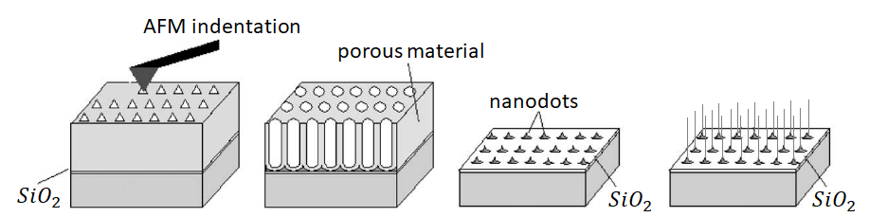
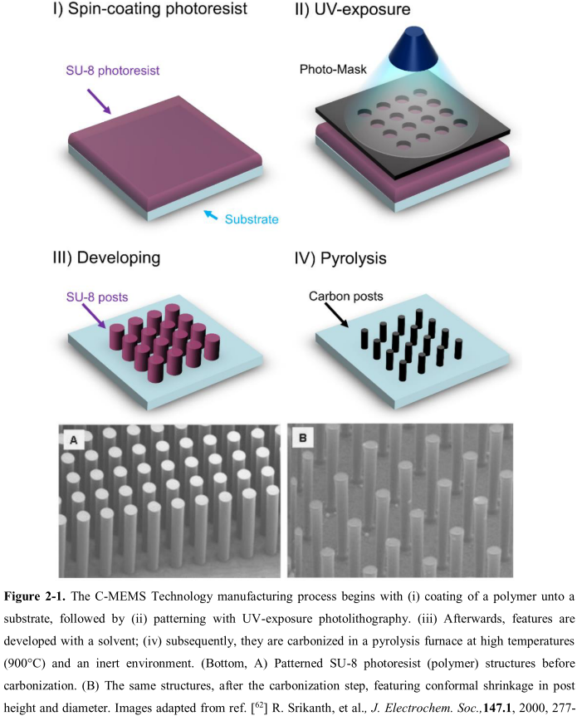
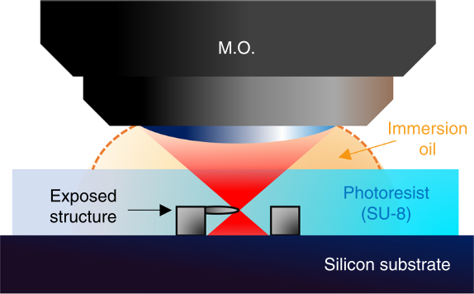
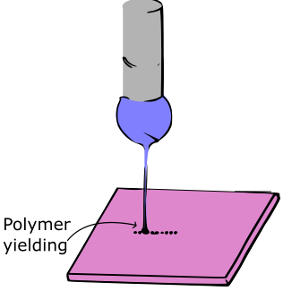
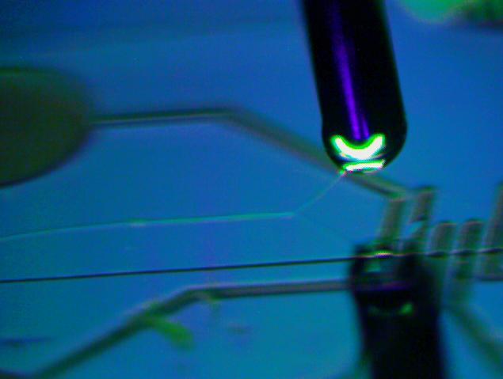
Current approaches for the fabrication of carbon nanostructures
Self-assembly
Limited Length and Random Orientation
Photolithography
Physical & Optical Limitations
Two-Photon Polymerization (TPP)
Slow (mm per sec) & Expensive
* Near-Field Electrospinning (NFES)
Suspended Nanowires w/Spatial Control
V. Galstyan, M. Bhandari, V. Sberveglieri, G. Sberveglieri, E. Comini, Metal Oxide Nanostructures in Food Applications: Quality Control and Packaging, Chemosensors. 6 (2018) 16. https://doi.org/10.3390/chemosensors6020016.
D. Kluge, J.C. Singer, B.R. Neugirg, J.W. Neubauer, H.-W. Schmidt, A. Fery, Top–down meets bottom–up: A comparison of the mechanical properties of melt electrospun and self-assembled 1,3,5-benzenetrisamide fibers, Polymer (Guildf). 53 (2012) 5754–5759. https://doi.org/10.1016/j.polymer.2012.10.016.

Slide 5
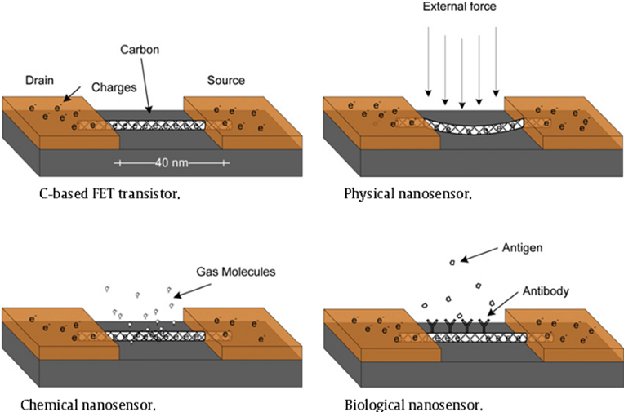
Applications of Carbon Nanowires (CNWs)
The carbon nanostructure changes its electrical properties with:
deformation (mass, pressure, force or displacement)
absorption/attachment of chemicals
biological processes such as antibody/antigen interaction, DNA interaction and cellular communication
I.F. Akyildiz, J.M. Jornet, Electromagnetic wireless nanosensor networks, Nano Commun. Netw. 1 (2010) 3–19. https://doi.org/10.1016/j.nancom.2010.04.001.
N. Rikhtegar, M. Keshtgary, A Brief Survey on Molecular and Electromagnetic Communications in Nano-Networks, Int. J. Comput. Appl. 79 (2013) 16–28. https://doi.org/10.5120/13721-1510.

Slide 6
Introduction: Project overview
To design polymer solutions that can be electrospun by NFES, photopolymerized, and then pyrolyzed into conductive carbon nano-wires.
Near-Field Electrospinning & Photopolymerization
Polymeric micro-fibers
Pyrolysis and Carbonization
Carbon nano-fibers
4-Wire Kelvin
Raman Spec.
SEM
Polymer Solution
SEM
Rheometry
Fabrication Process
Product
Characterization Technique

Slide 7
Polymer Solution Parameters

Slide 8
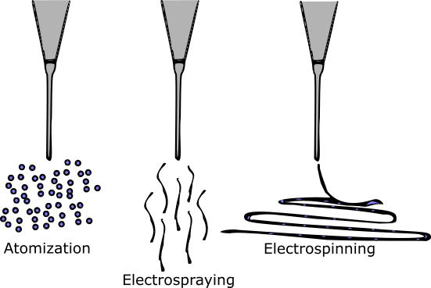
SU-8 Carbon Structures
The production of C-MEMS:
Polymer patterning through photolithography
Carbonization through pyrolysis
However, SU-8 as is can not electrospin
SU-8 does not have the right viscosity & solution conductivity
SU-8 is design for photolithography
Microchem, Su-8 2000.5-2015, 2000.5, 2002, 2005, 2007, 2010, 2015. (2006) 1–5. papers3://publication/uuid/859F51B9-0382-4DE8-88A9-267F936939A3.

Slide 9
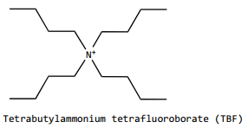
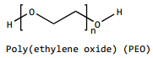
Making SU-8 spunable (by Braulio & Ricardo)
SU-8 + TBF + PEO
To increase the solution conductivity
To provided the required viscosity
… both needed for smooth PEO flow during electrospinning
B. Cárdenas, Advanced Manufacturing Techniques for the Fabrication and Surface Modification of Carbon Nanowires, (2017) 160.
D.R. Flores, Role of rheological properties in near field electrospun fibers morphology, (2017) 130.
Notes:
Surface t-

Slide 10
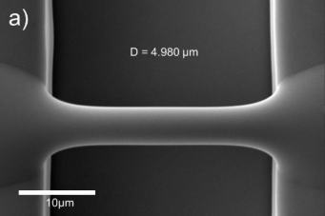
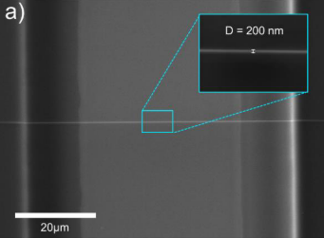
Results with amended SU-8
The modified solution is spunable
Fiber diameter before pyrolysis of 4.966 μm
Fiber diameter after pyrolysis of 204 nm
But, somewhat pyrolyzable
Fiber resistivity from 407 KΩ to 1.727 MΩ
Fiber yield rate of 81 %
Achieved with:
wt% PEO 0.25 | SU-8 2002 [mg] | PEO [mg] | TBT [mg]
 | 2246 | 5.65 | 11.32
= 2 ml of solution
B. Cárdenas, Advanced Manufacturing Techniques for the Fabrication and Surface Modification of Carbon Nanowires, (2017) 160.

Slide 11
Implications of PEO, as it introduces oxygen to the solution
The fiber yield rate and fiber conductivity are impacted negatively.
Some samples are destroyed during pyrolysis
High variance in the obtained conductivity across samples.
In the presence of oxygen, the char yield decreases. This is due to the oxidation on the char.
Notes:
Surface t-

Slide 12
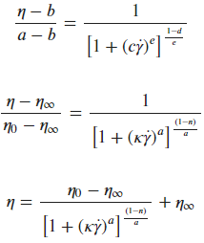
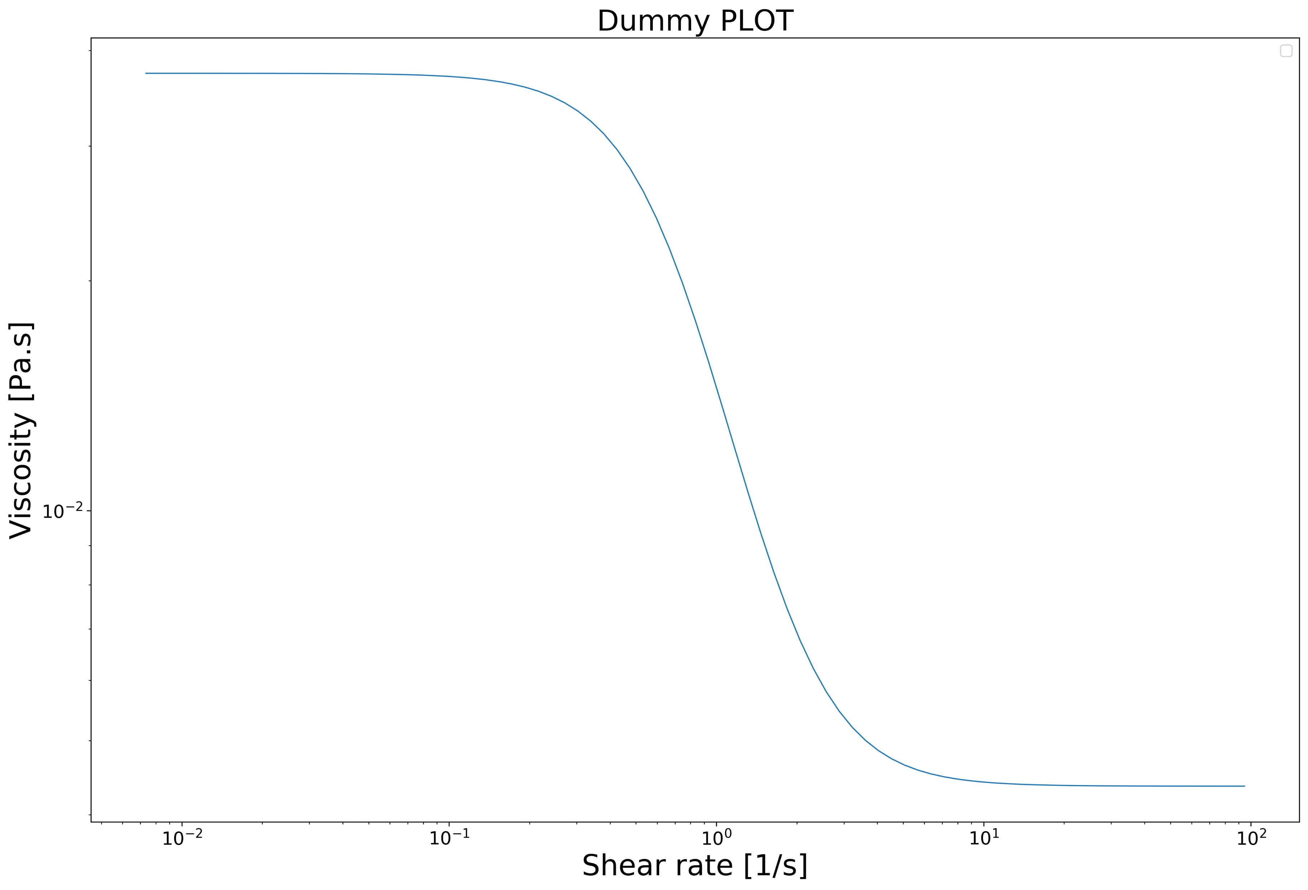
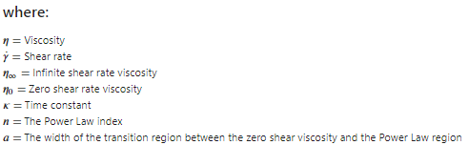
The Carreau-Yasuda Model
zero shear rate viscosity
power law region
infinite shear rate viscosity
Osswald, T., Rudolph, N., Osswald, T., & Rudolph, N. (2014). Generalized Newtonian Fluid (GNF) Models. Polymer Rheology, 59–99. https://doi.org/10.3139/9781569905234.003

Slide 13
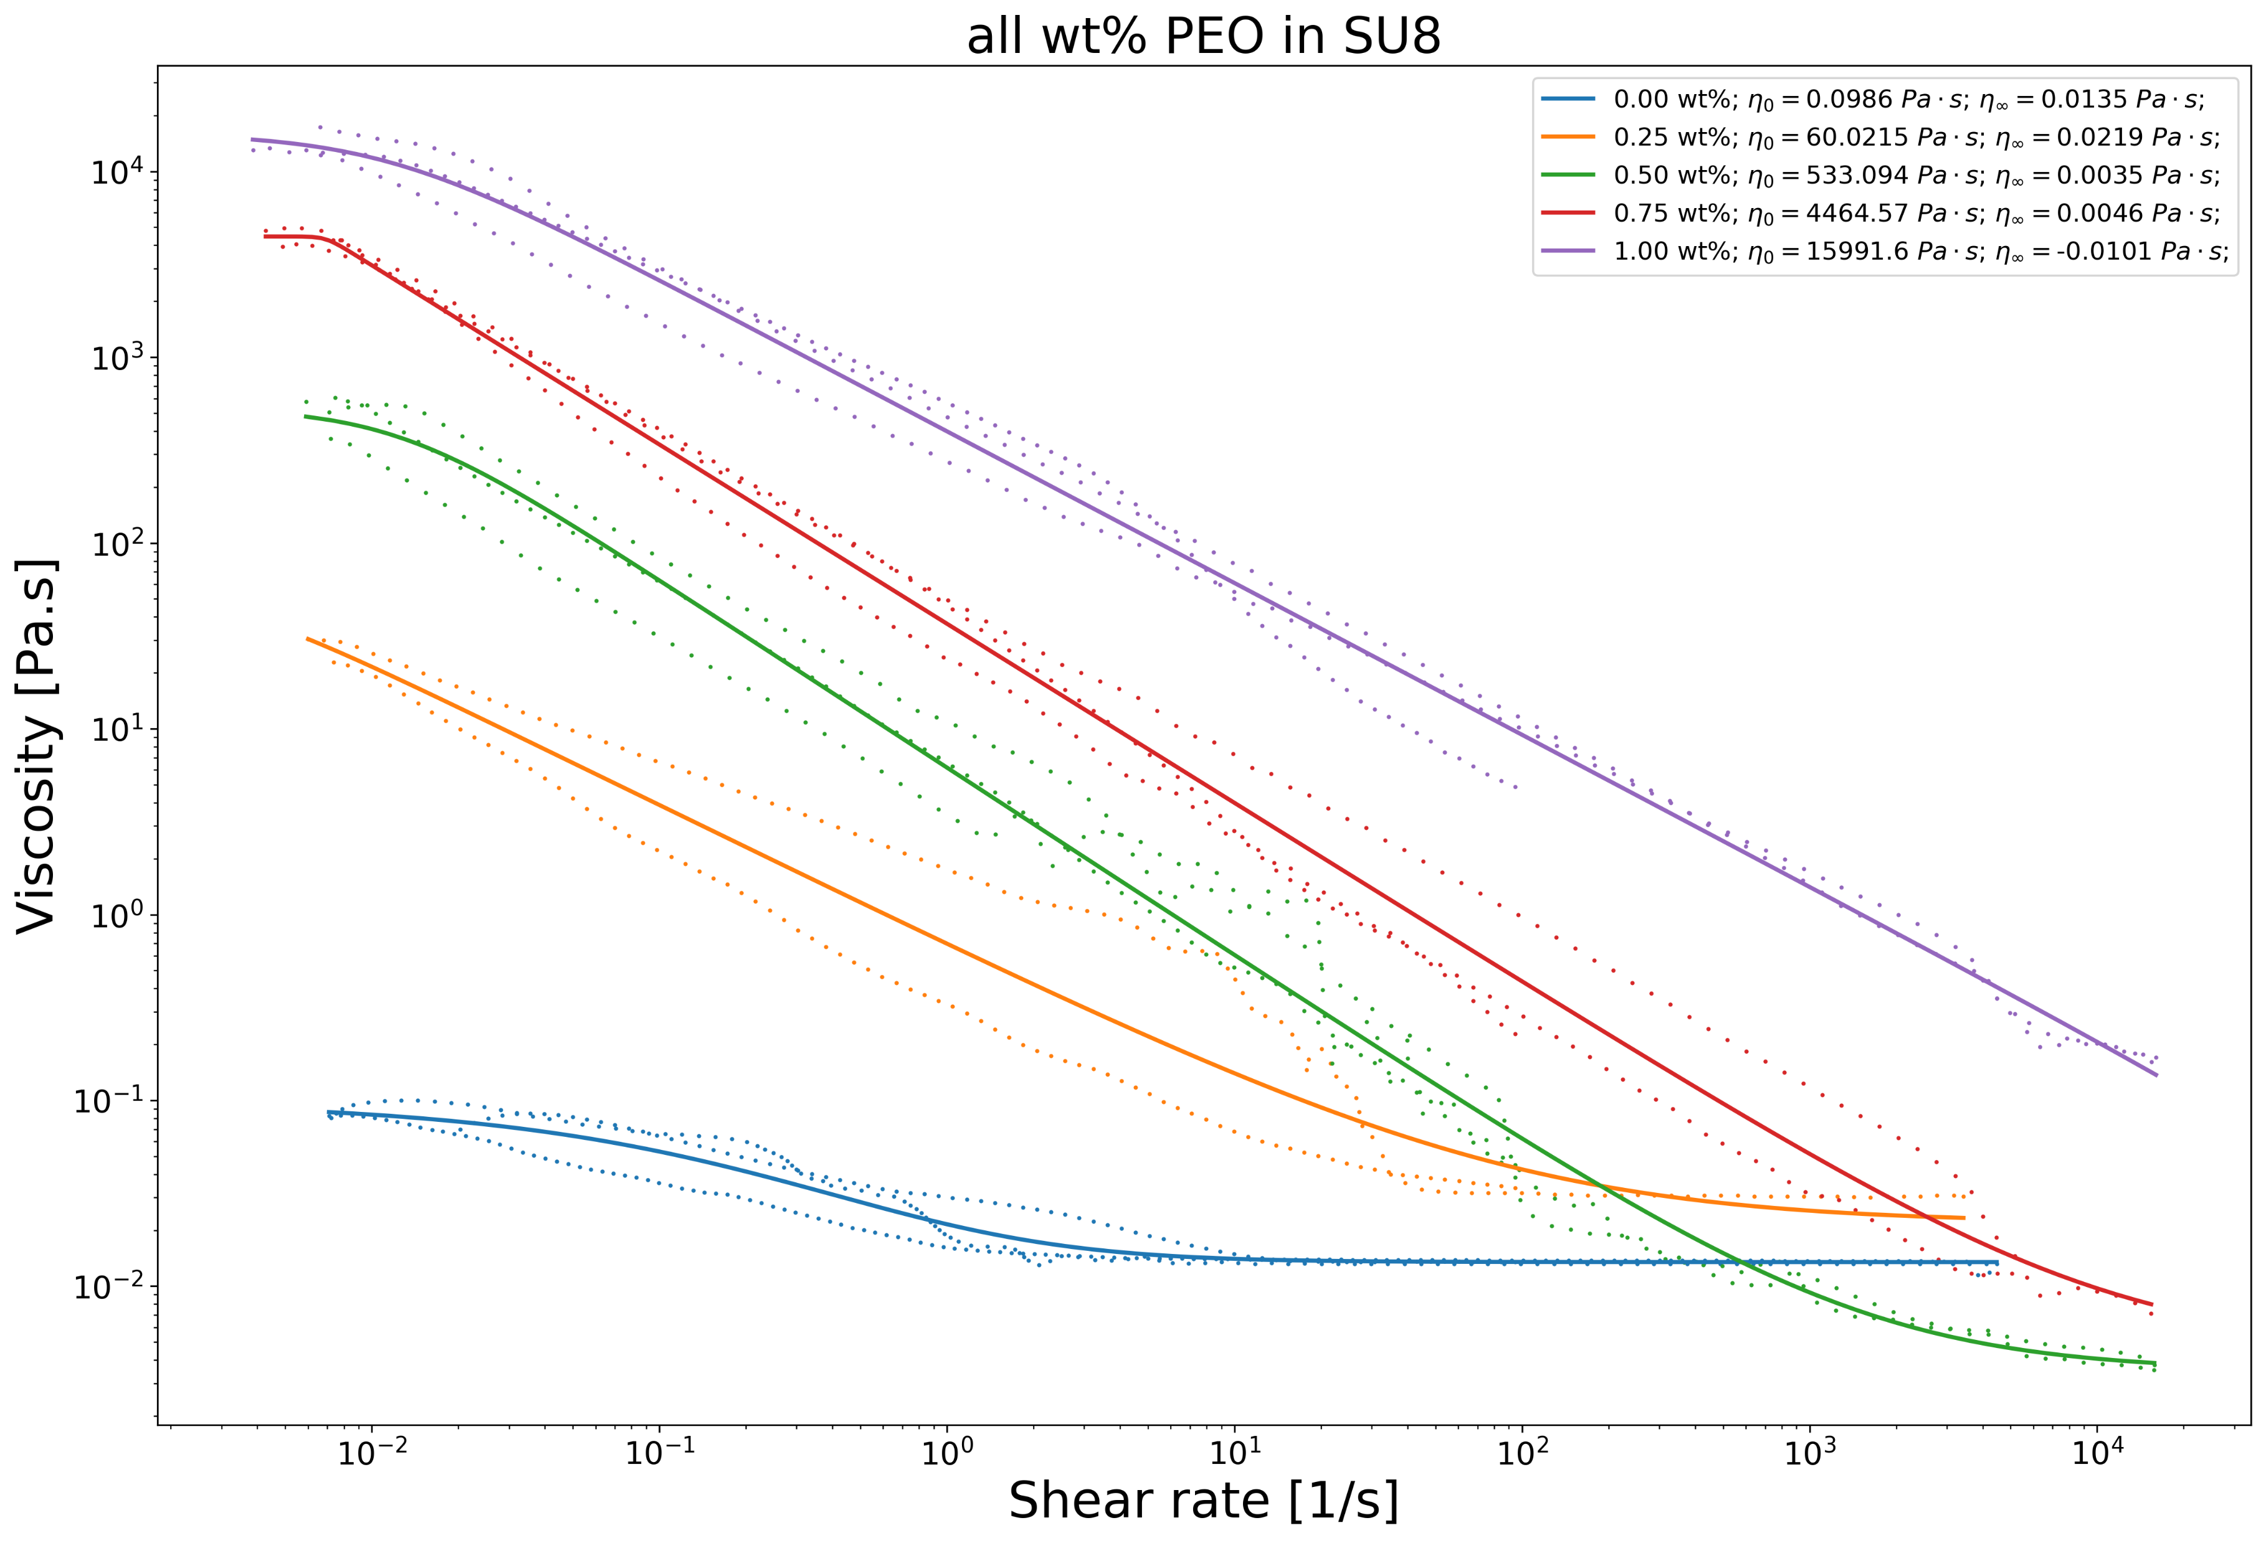
Rheology of the amended SU-8 solution (0.25 wt%)
The 0.25 wt% sample (orange line) has a zero-shear viscosity (ZSV) of 60 Pa.s spunable at 600 V
Let’s discover new polymer solutions with similar rheology (and no oxygen)

Slide 14
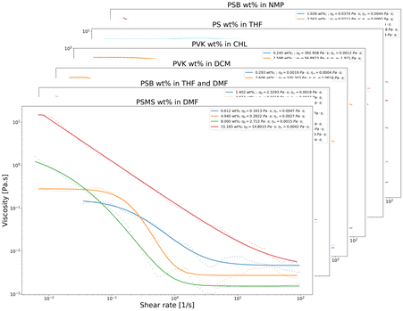
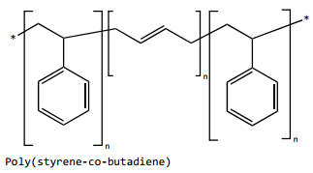
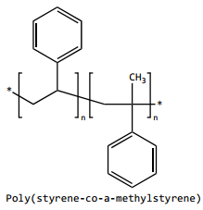
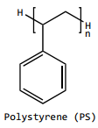
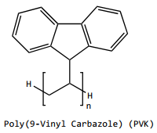
Rheology of the proposed polymer solutions
15 wt% in NMP
25 wt% in THF & DMF
15 wt% in DMF
35 wt% in THF
Solutions with similar rheology of that of the 0.25wt% PEO SU-8 solution with about 60 Pa.s ZSV each.
8 wt% in CHL
7 wt% in DCM

Slide 15
NFES Process Parameters

Slide 16
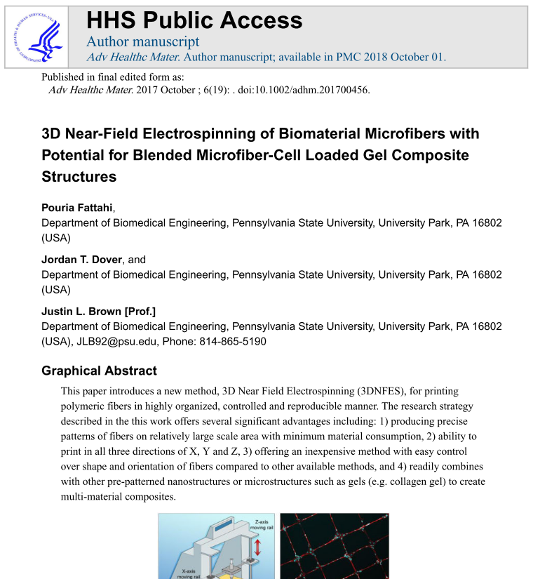
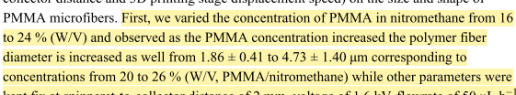
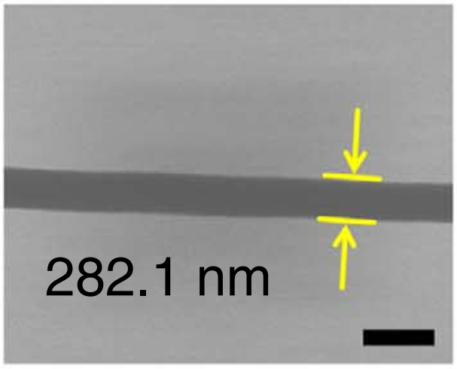
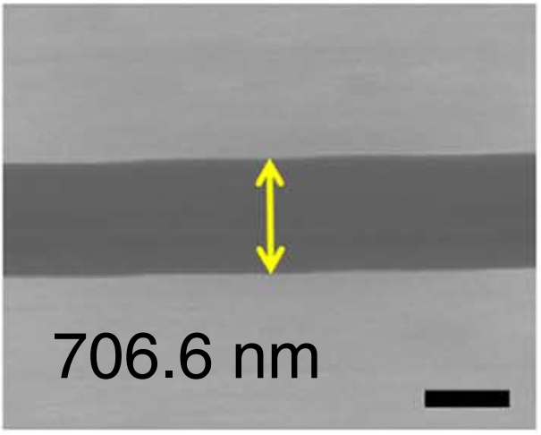
Data collection of NFES literature (analysis of ~360 fibers in articles from 2003 to 2020)
Use case 1 (ideal case): The author mentions the process parameters and fiber properties within the article in writing.
Fattahi2017
Figures from Min2013

Slide 17
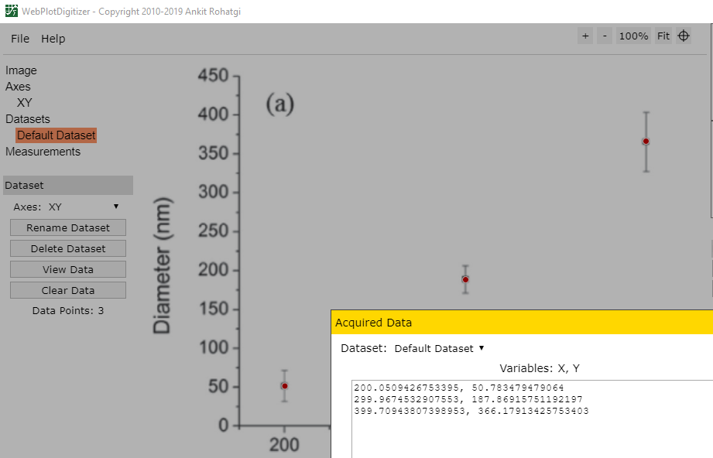
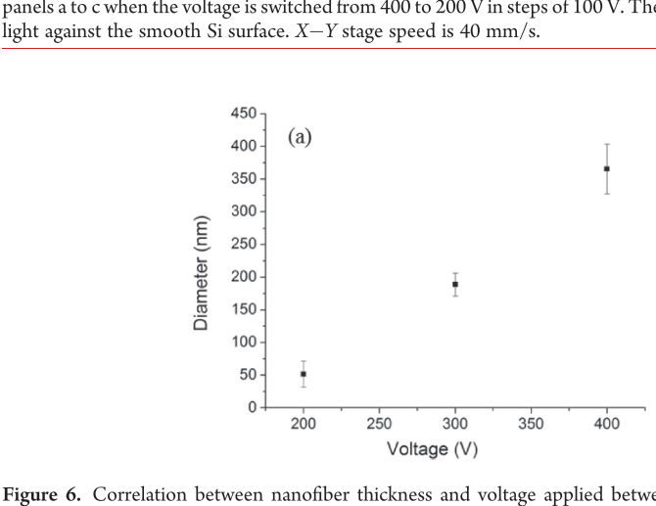
Data collection of NFES literature (analysis of ~360 fibers in articles from 2003 to 2020)
Use case 2 (typical case): The author provides the data in plots and graphs.
WebPlotDigitalizer (https://github.com/ankitrohatgi/WebPlotDigitizer):
M.J. Madou, D. Dunn-Rankin, L. Kulinsky, A. Mirsepassi, G.S. Bisht, S. Oh, G. Canton, Controlled Continuous Patterning of Polymeric Nanofibers on Three-Dimensional Substrates Using Low-Voltage Near-Field Electrospinning, Nano Lett. 11 (2011) 1831–1837. https://doi.org/10.1021/nl2006164.
Applied voltage vs. fiber diameter by Madou2011

Slide 18
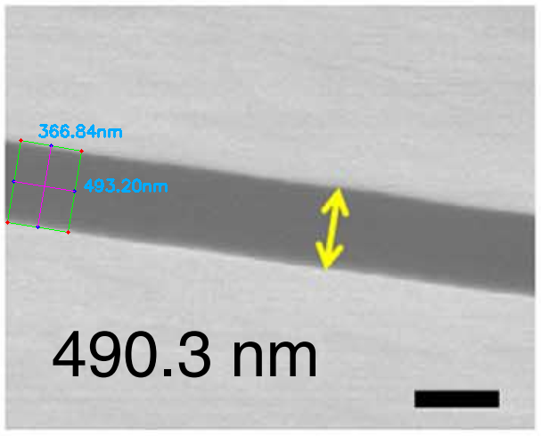
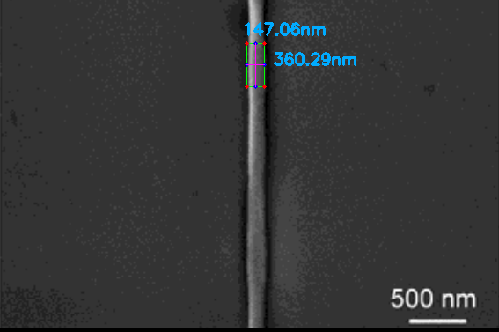
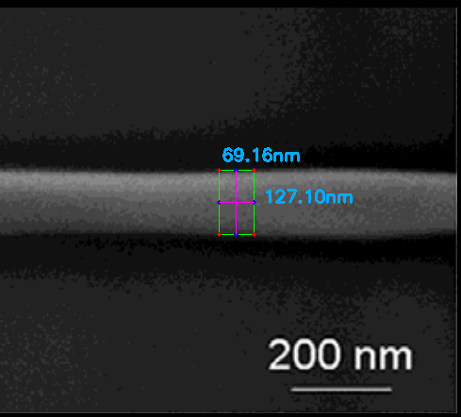
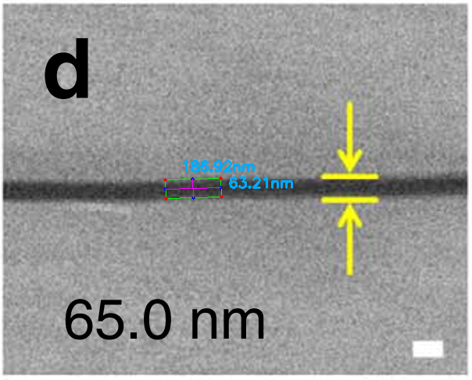
Data collection of NFES literature (analysis of ~360 fibers in articles from 2003 to 2020)
Use case 3 (difficult case): The author does not mention the fiber diameter in writing but provides a EM characterization.
Python Image Analysis (with a 4.3% error in avg.):
Figure from Camillo2013
Figures from Min2013
Figure from Camillo2013
https://github.com/katagirimx/OpenCV-image-measuring

Slide 19
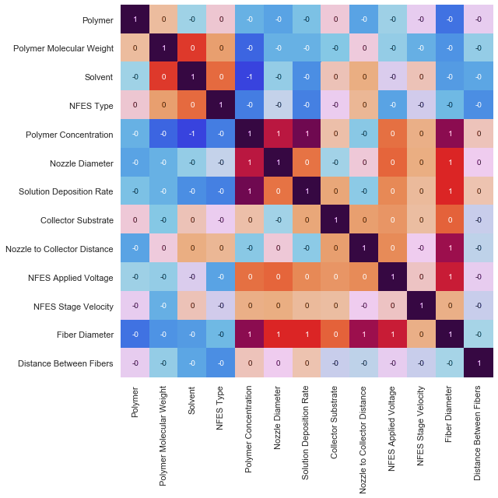
Polymer Concentration,
Nozzle Diameter,
Solution Deposition Rate,
Nozzle to Collector Distance &
Applied Voltage
are the main drivers of the final Fiber Diameter

Slide 20
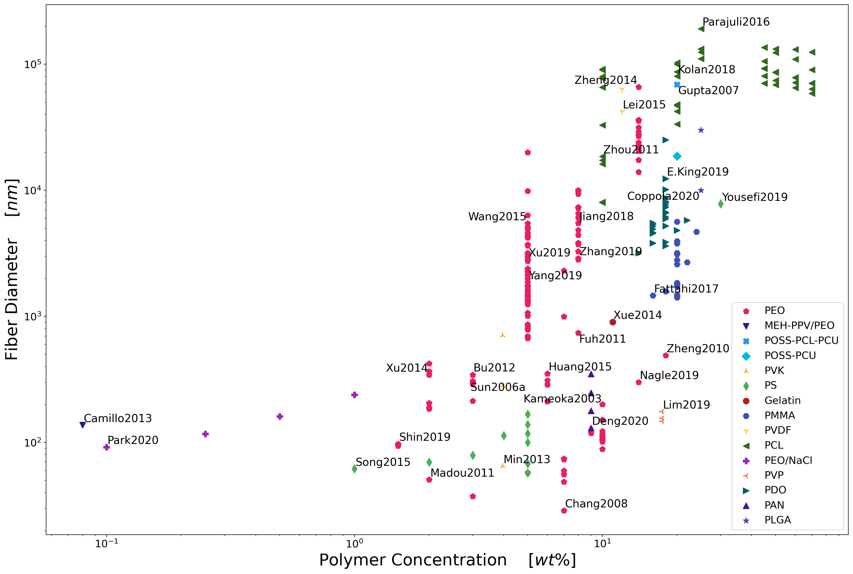
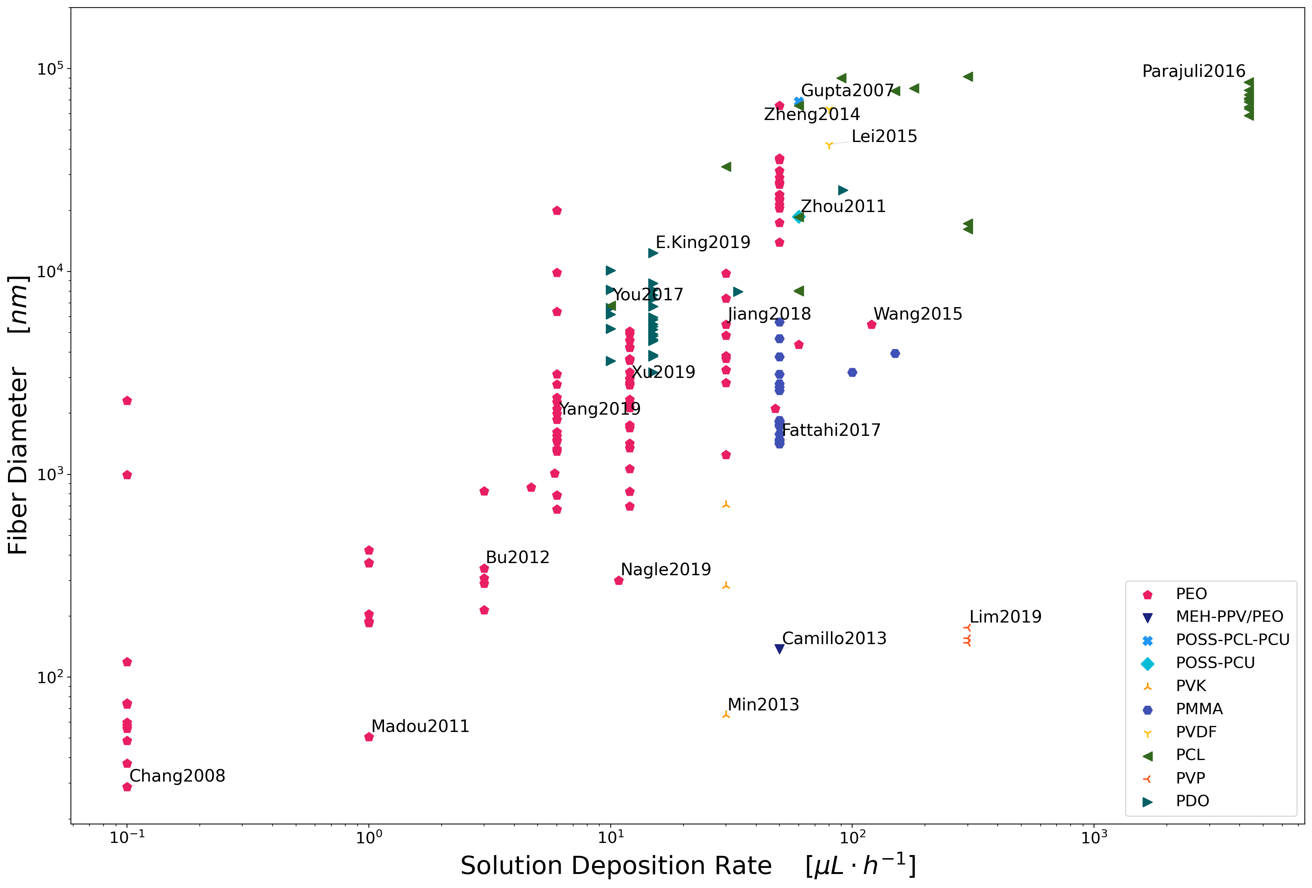
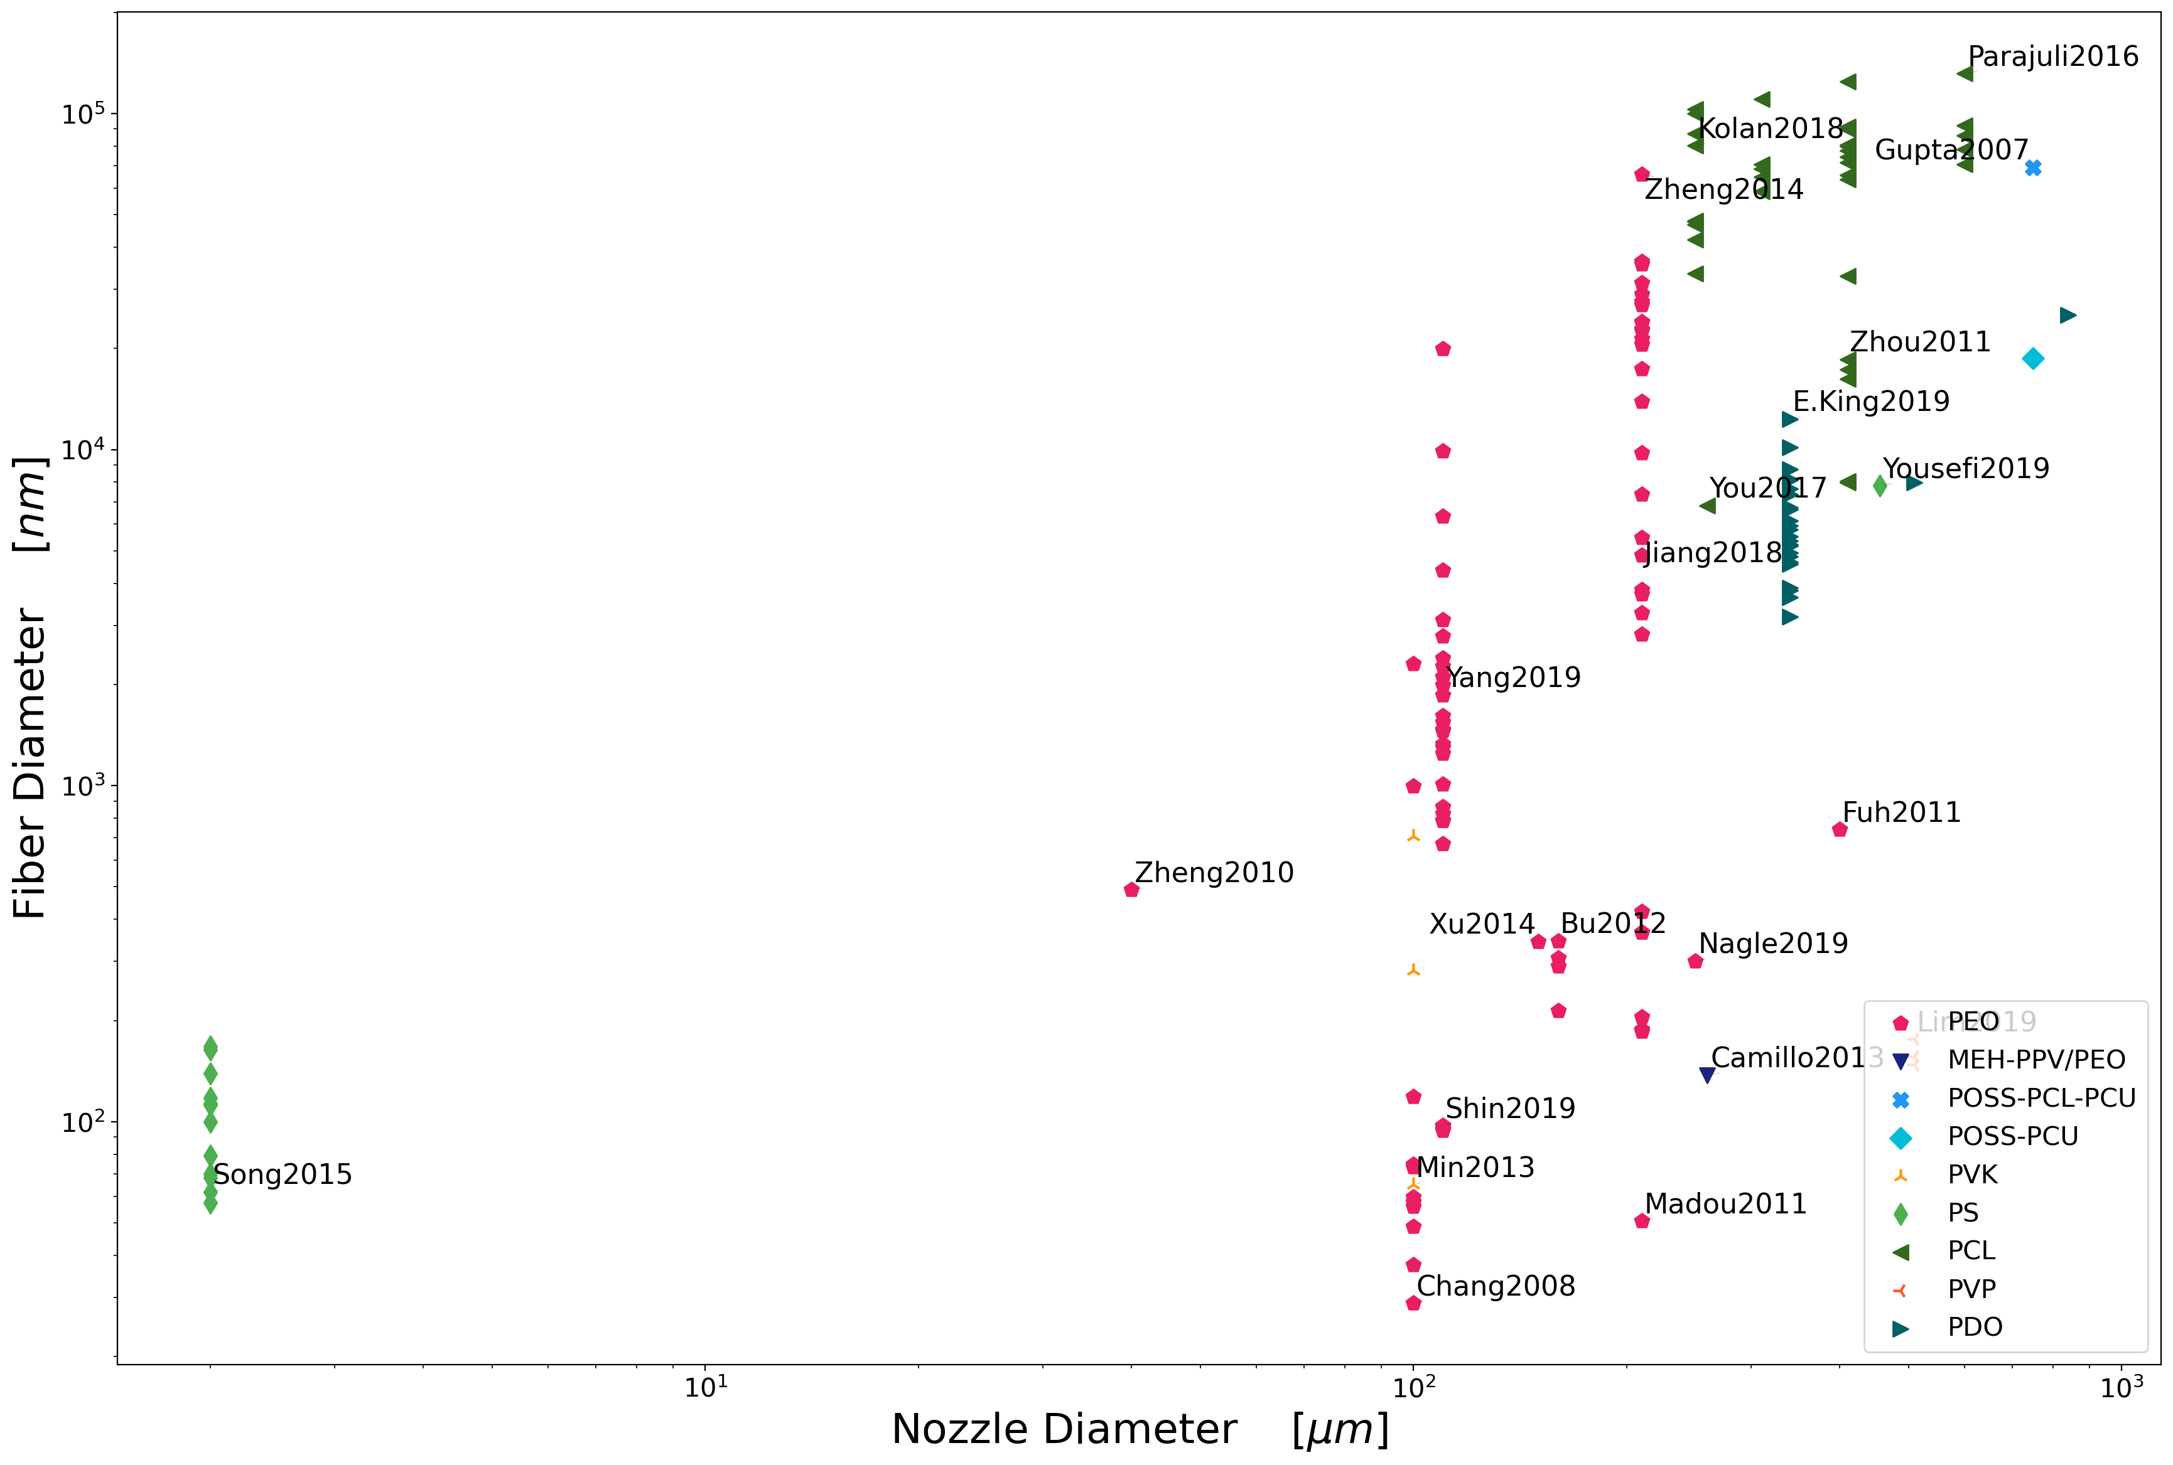
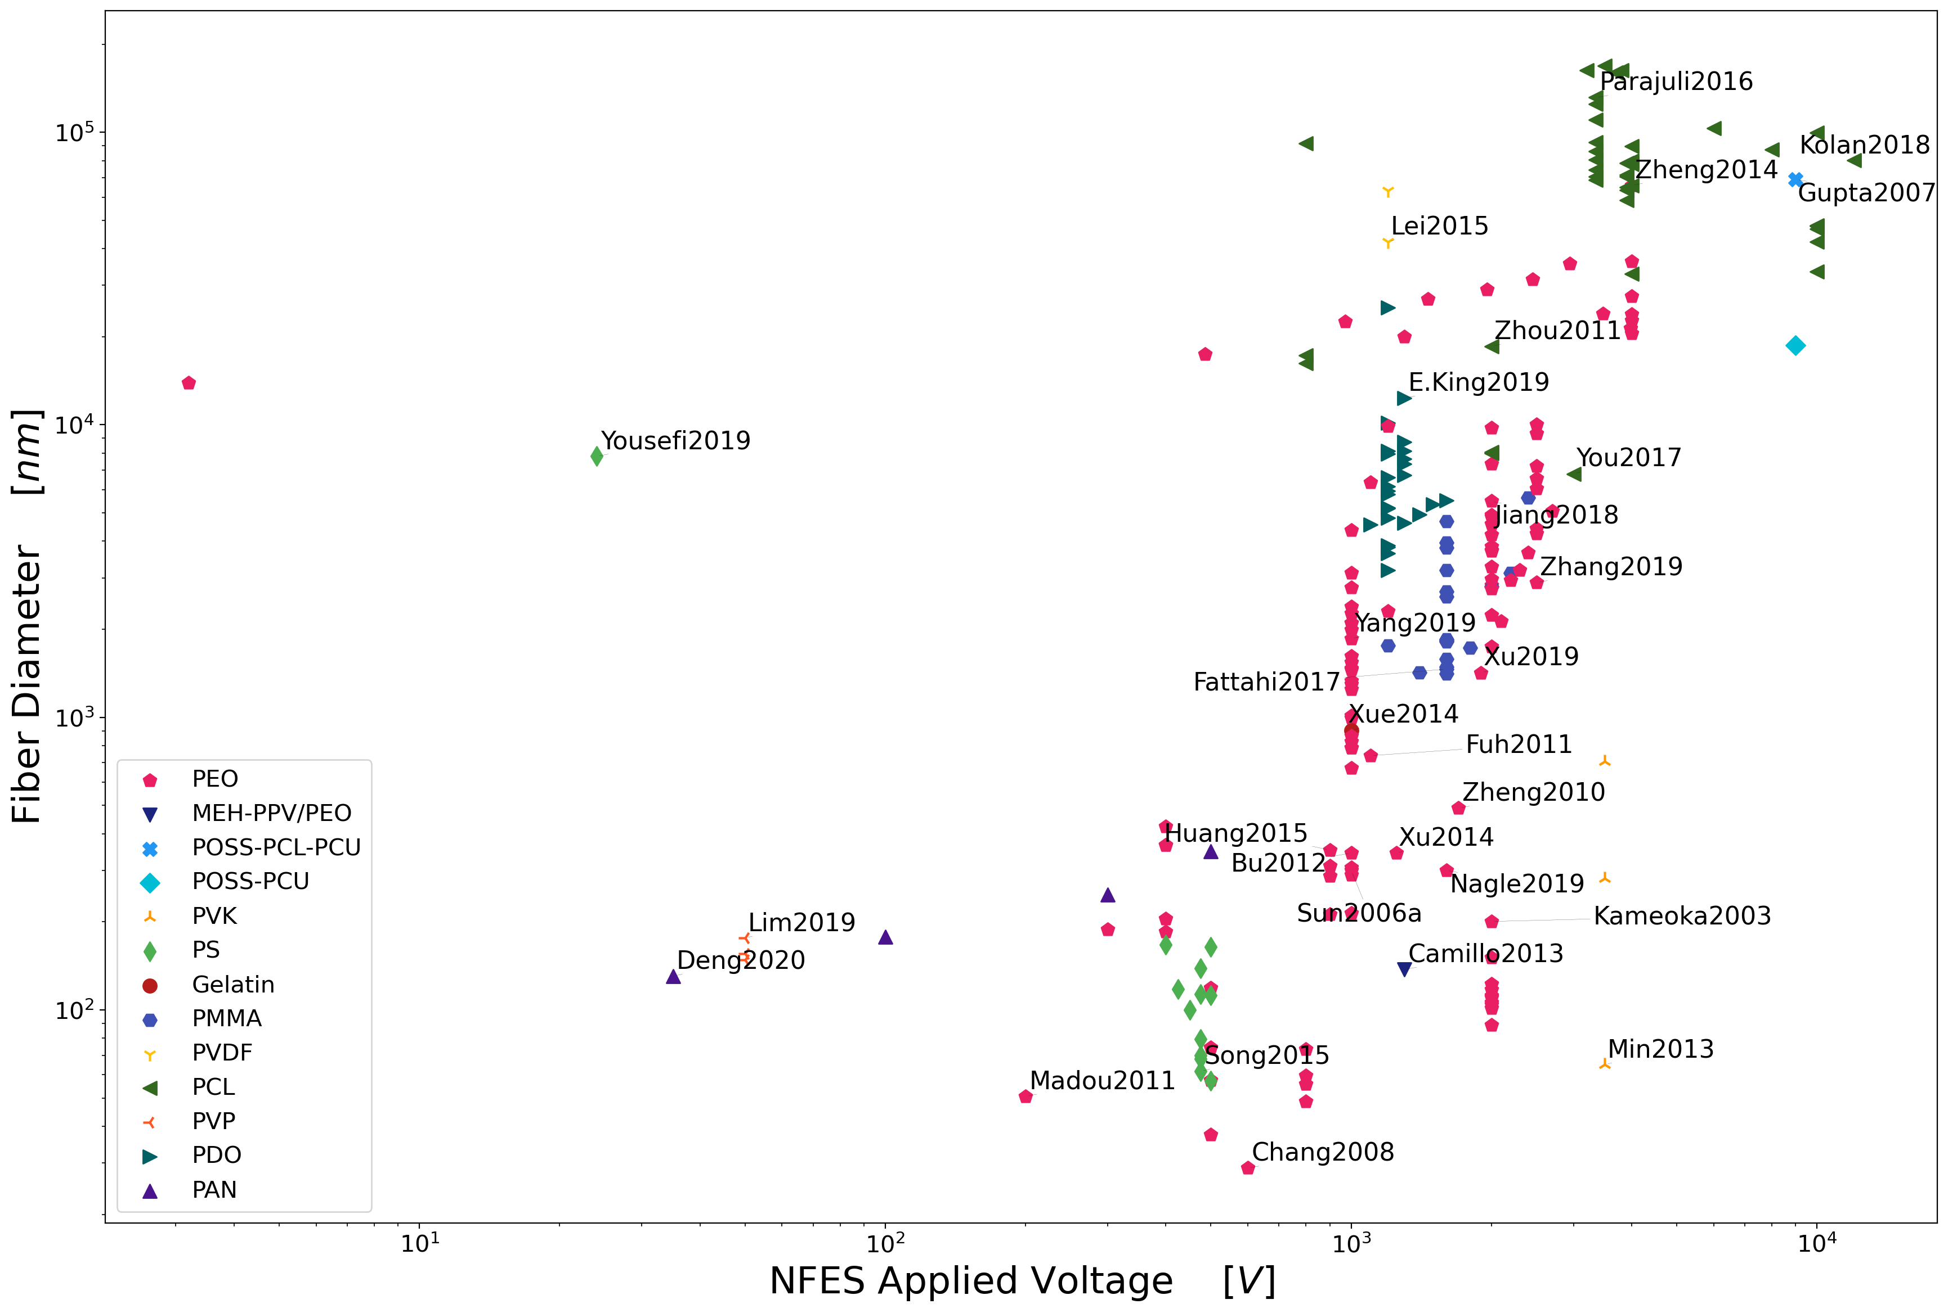
low polymer concentrations
slow solution deposition rates
small nozzle
diameters
low voltages

Slide 21
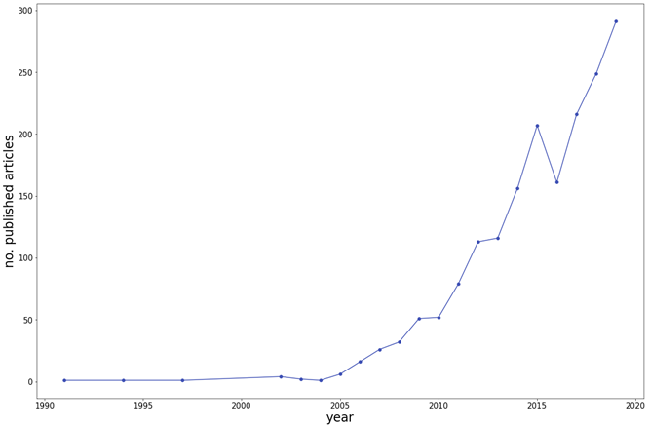
History of NFES literature (first NFES apparatus built in 2003 by J. Kameoka et al.)
Thinnest fiber achieved by C. Chang et al. with ~50 nm in diameter. (PEO in water)
However, Fiber yield rate was not reported
J. Kameoka, R. Orth, Y. Yang, D. Czaplewski, R. Mathers, G.W. Coates, H.G. Craighead, A scanning tip electrospinning source for deposition of oriented nanofibres, Nanotechnology. 14 (2003) 1124–1129. https://doi.org/10.1088/0957-4484/14/10/310.
C. Chang, K. Limkrailassiri, L. Lin, Continuous near-field electrospinning for large area deposition of orderly nanofiber patterns, Appl Phys Lett. (2008) 3. https://doi.org/10.1063/1.2975834.

Slide 22
Overall Progress & Next Steps

Slide 23
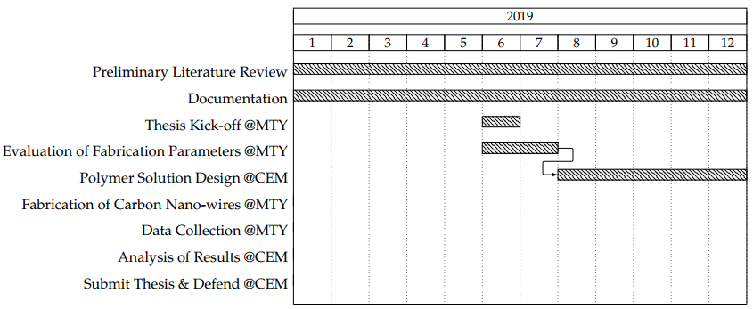
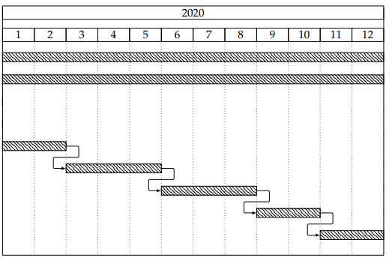
Current Work Plan
Literature contributions
rheology
today

Slide 24
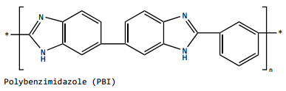
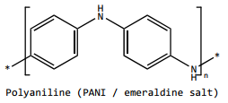
Next step: Study/Test the proposed polymer solutions
high carbon polymers and no oxygen
+15 wt% in DMF
~15 wt% in NMP
~25 wt% in THF & DMF
+35 wt% in THF
No records
No records
~8 wt% in CHL

Slide 25
Conclusions:
<Conclusion A>
<Conclusion B>

Slide 26


Slide 27
Carbon nanostructures via Lithography
The production of C-MEMS:
Polymer patterning through photolithography electrospinning
Carbonization through pyrolysis
● SU-8 Waste
● Physical & Optical Limitations
● Structure Limitations
photolithography process

Slide 28
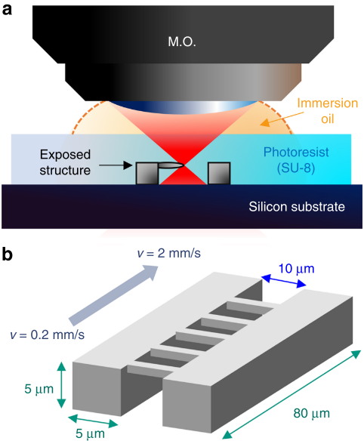
TPP – Two-Photon Polymerization
B. Cardenas-Benitez, C. Eschenbaum, D. Mager, J.G. Korvink, M.J. Madou, U. Lemmer, I. De Leon, S.O. Martinez-Chapa, Pyrolysis-induced shrinking of three-dimensional structures fabricated by two-photon polymerization: experiment and theoretical model, Microsystems Nanoeng. 5 (2019). https://doi.org/10.1038/s41378-019-0079-9.

Slide 29
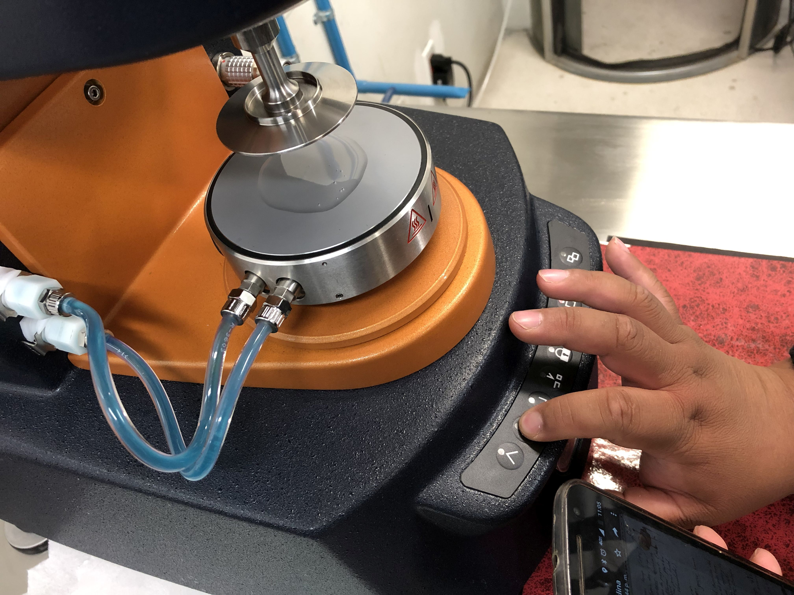
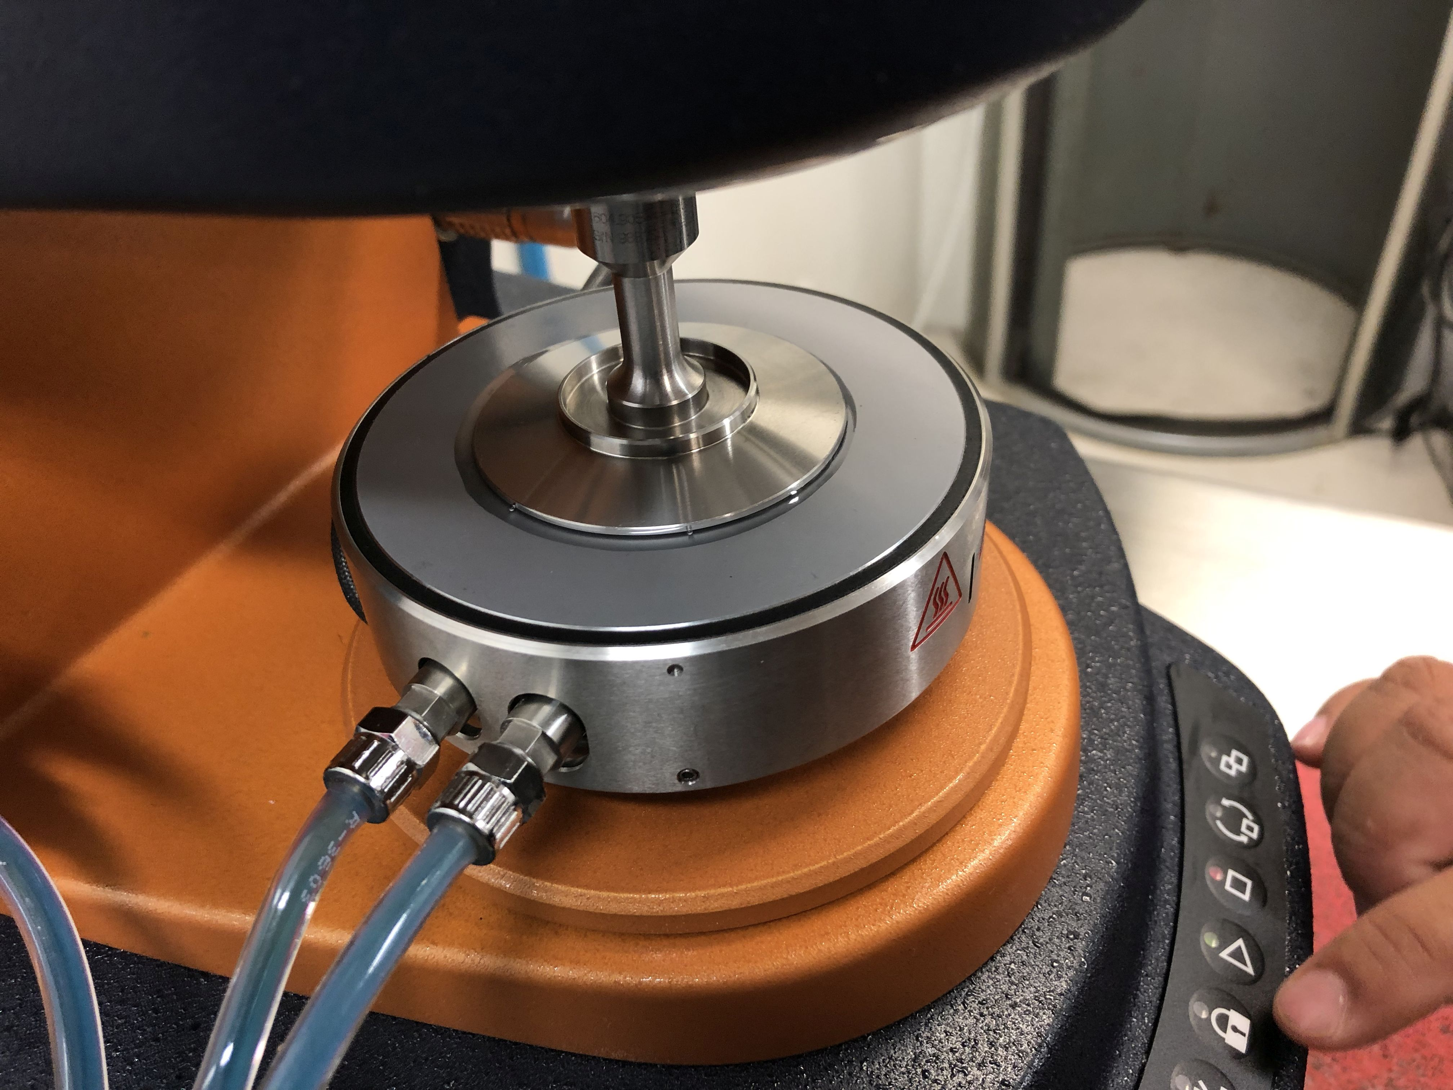
Characterization of the 0.25 wt% PEO Solution
Notes:
Surface t-

Slide 30
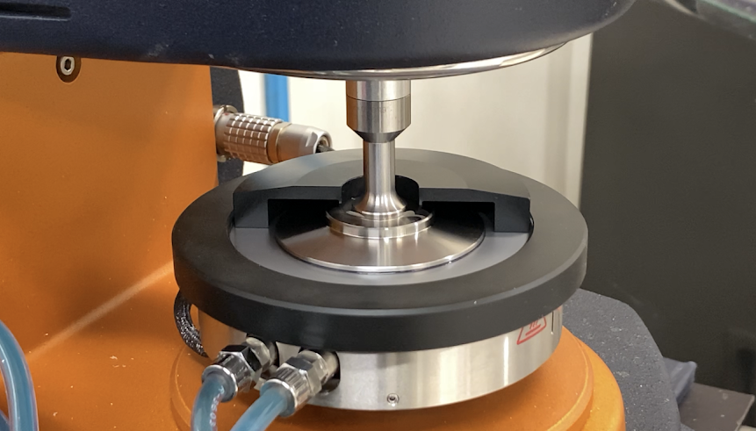

Slide 31
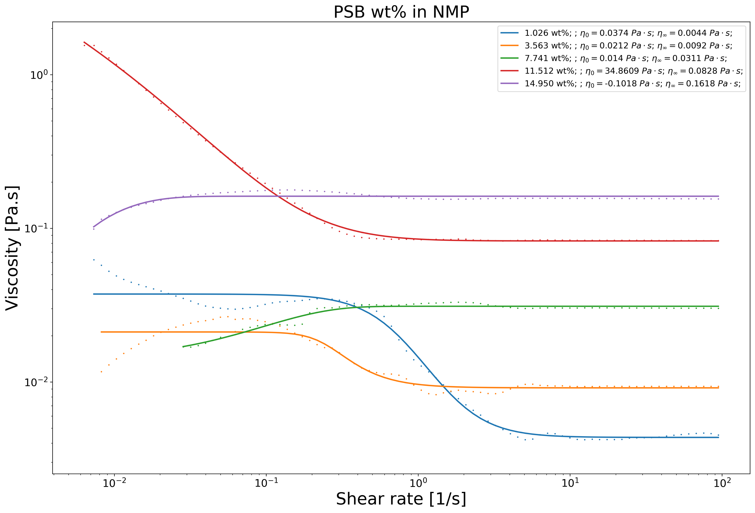
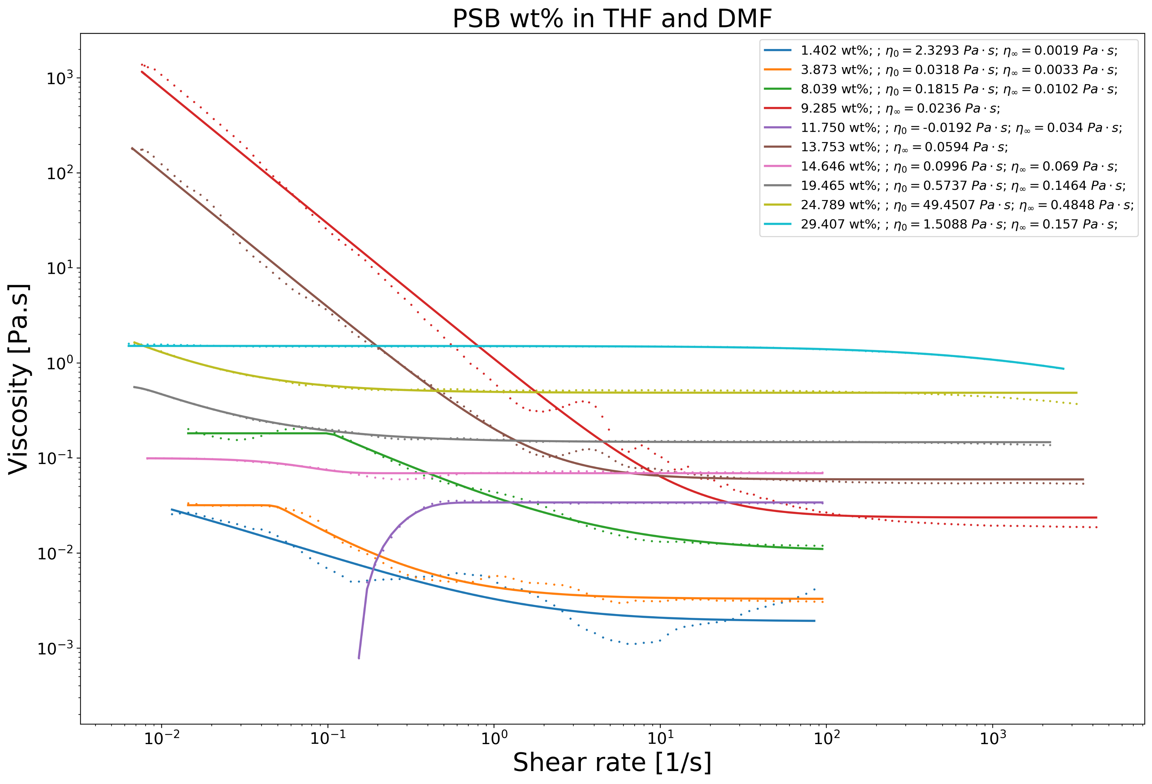
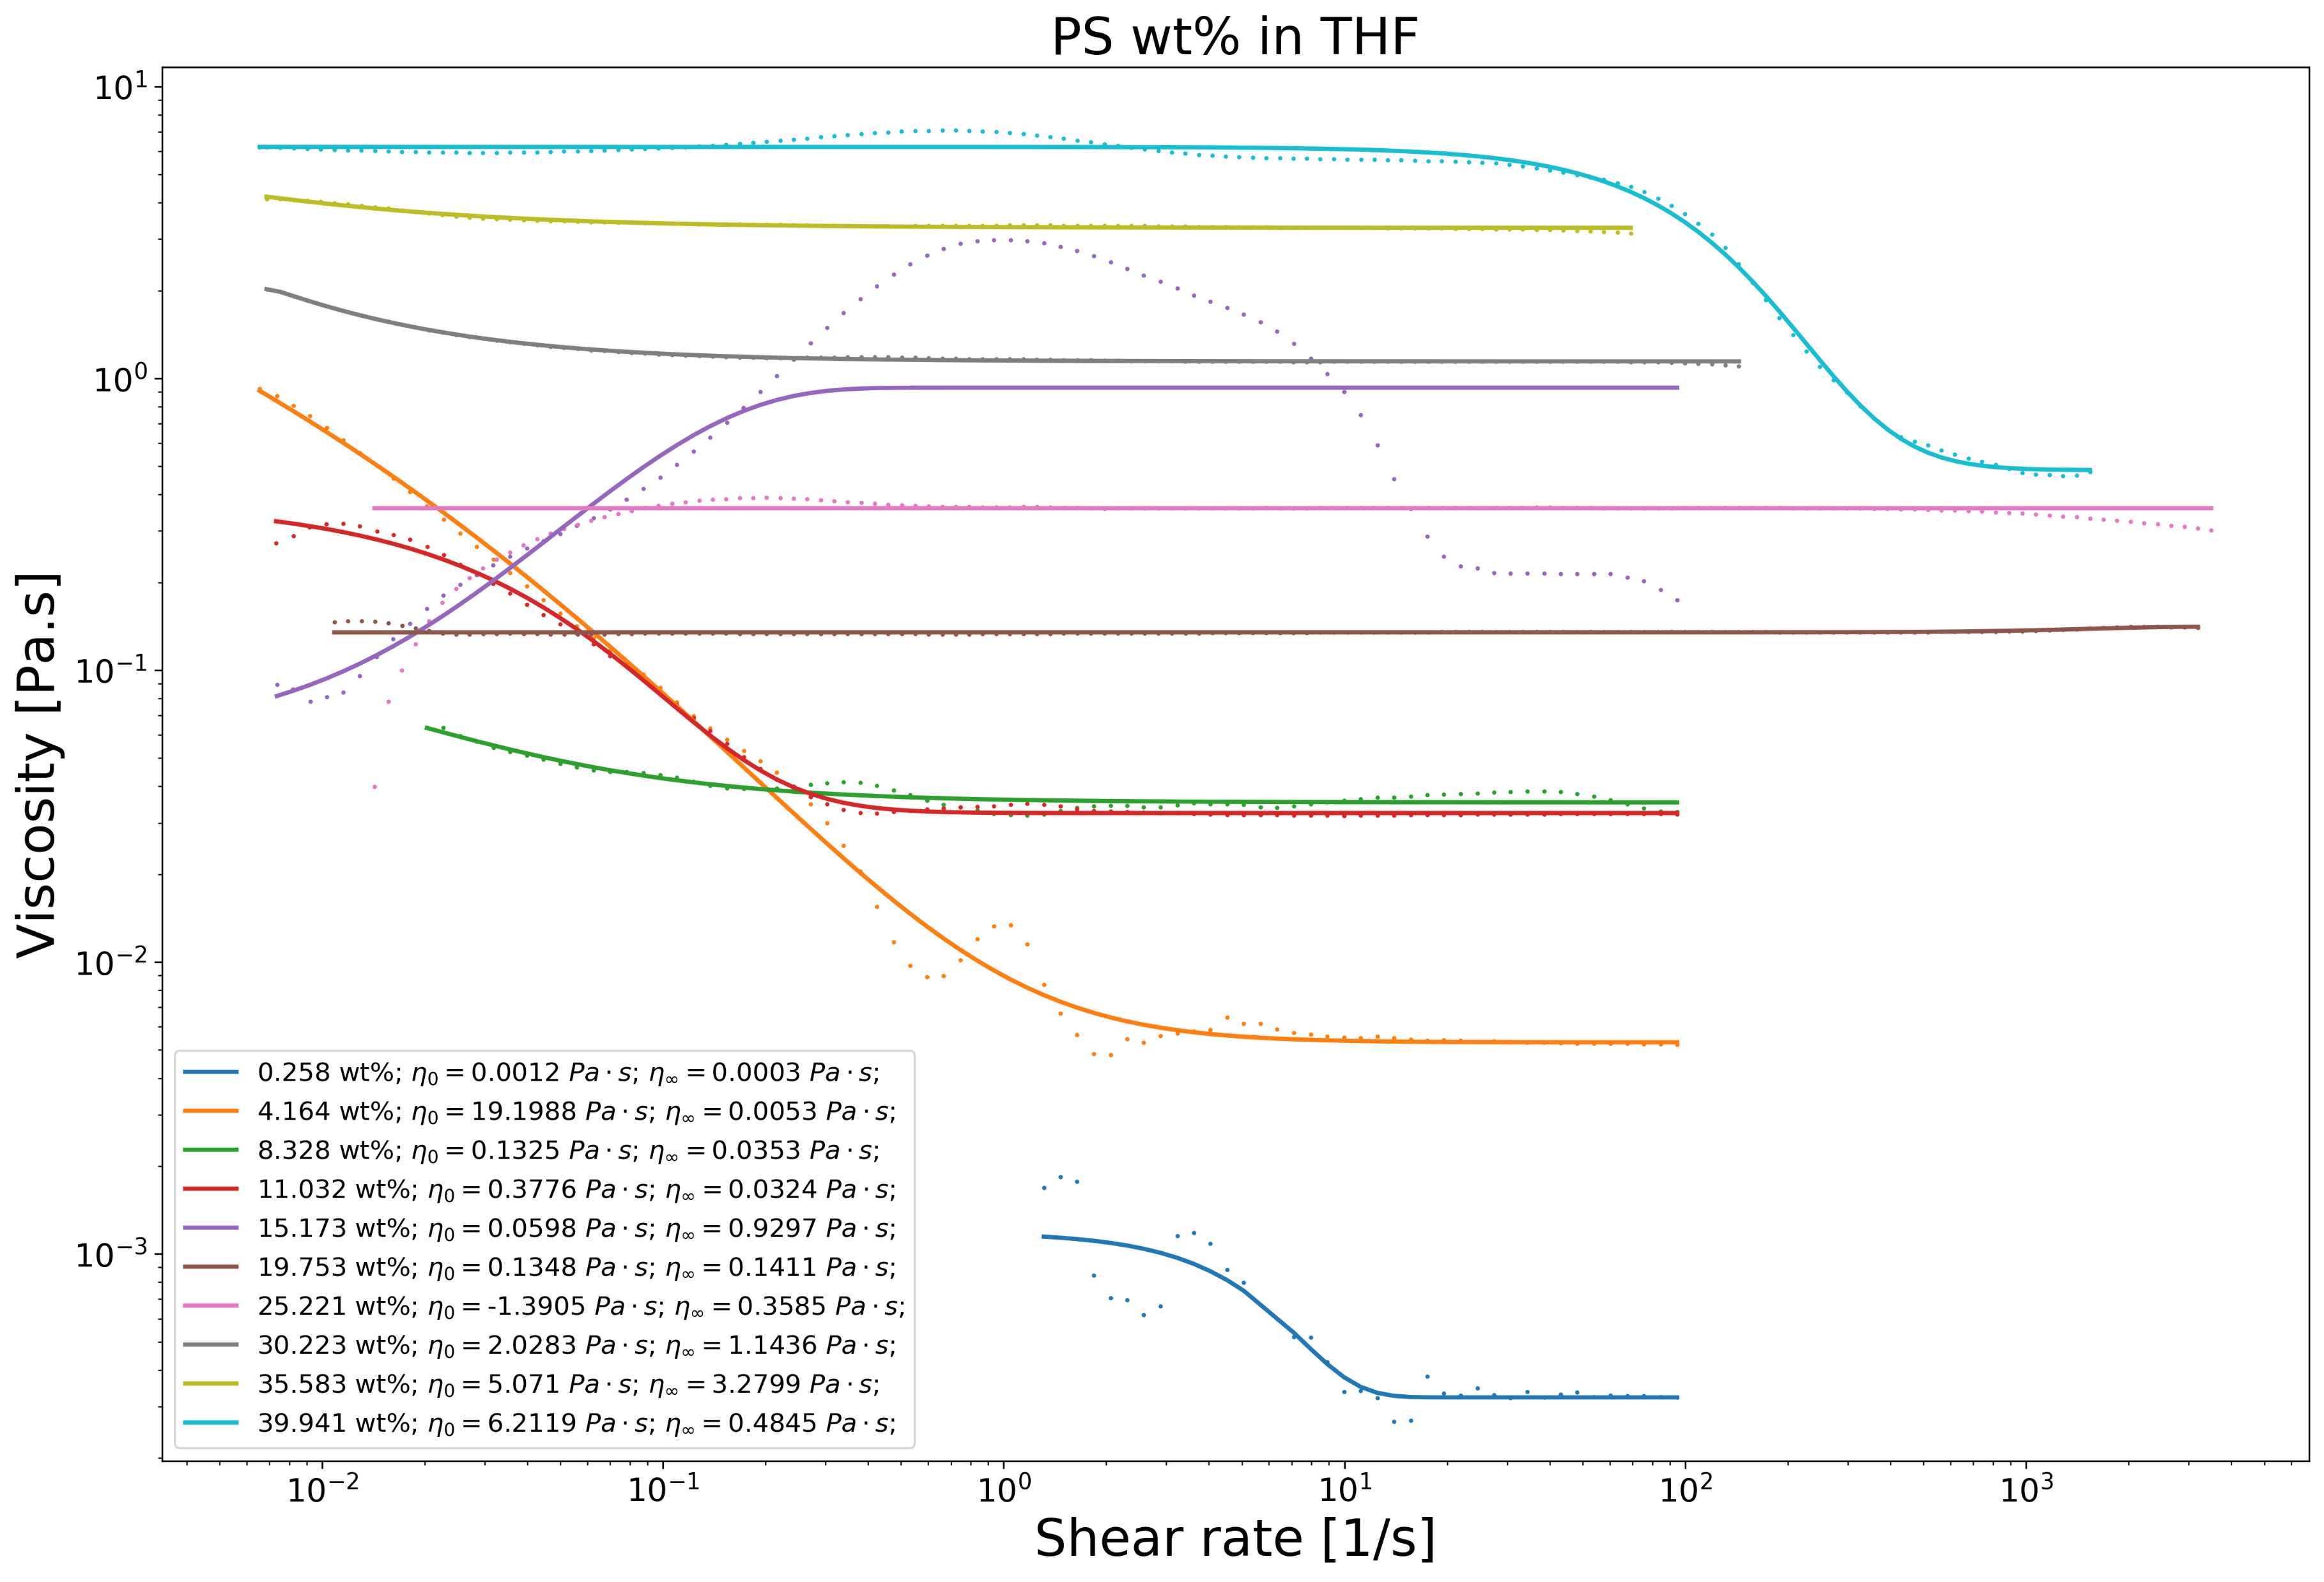
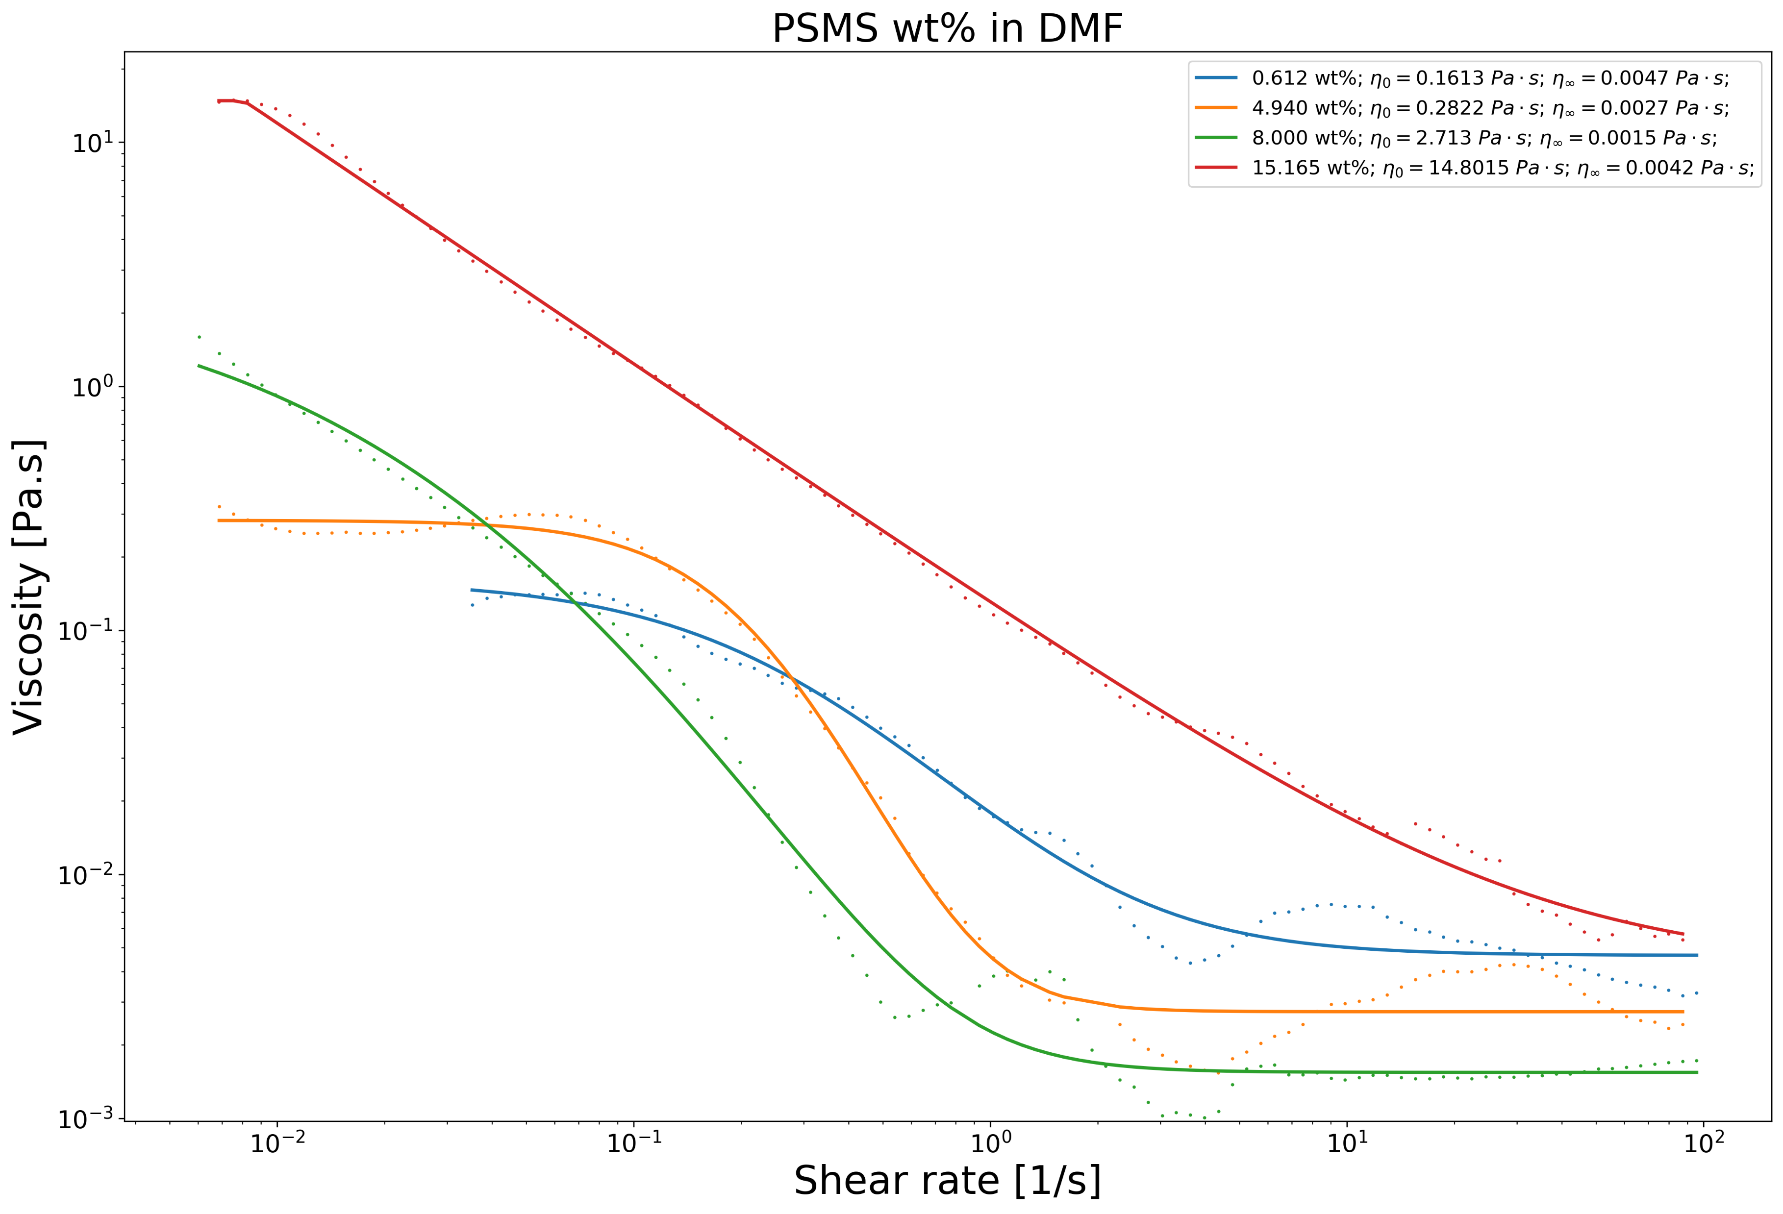
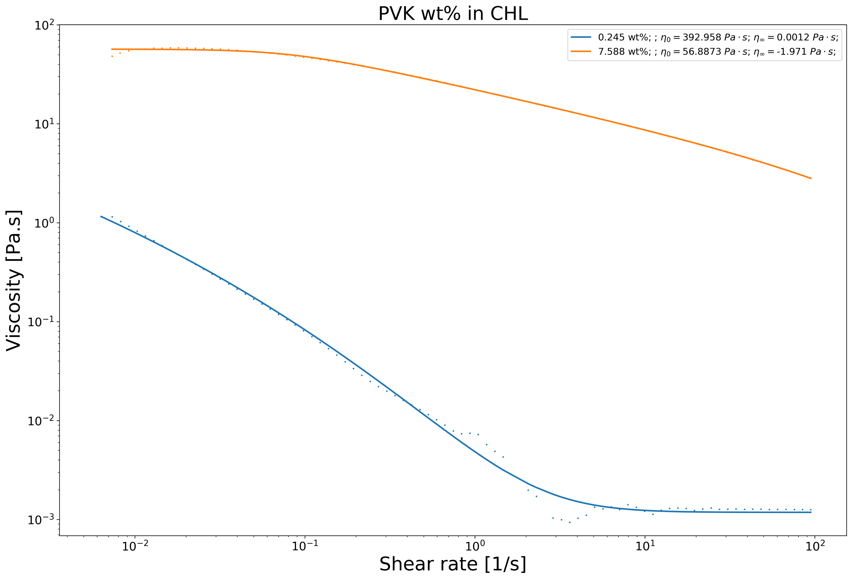

25 wt% in THF & DMF
15 wt% in NMP
15 wt% in DMF
35 wt% in THF
8 wt% in CHL
7 wt% in DCM

Slide 32



Slide 33



Characterization of the 0.25 wt% PEO Solution
Electrospun-able with an applied voltage of 600V.
Unable to initiate the jet at 500V or lower.
600V
700V
Notes:
Surface t-

Slide 34




Slide 35



Slide 36
PEO Solution
The EMS polymer solution consisted of
2ml of SU-8 2002 mixed with
0.5 wt% of Poly(ethylene oxide) (PEO, 4,000,000 MW; SigmaAldrich Inc., Cat. N. 189464) and
0.5 wt% Tetrabutylammonium Tetrafluoroborate salts (TBATFB; SigmaAldrich Inc., Cat. N. 217964) to increase its conductivity and allow smooth polymer flow during electrospinning.
All reagents were used as received. Magnetic stirring of these components was performed for 1hr at 75°C and low rpm (100-150 rpm).

Slide 37


SU-8 (MicroChem, US)
Notes:
https://rsc.aux.eng.ufl.edu/_files/msds/309.pdf

Slide 38



SU-8 (MicroChem, US)
https://www.fishersci.com/shop/products/NC9901158/nc9901158#?keyword=SU-8++developer
https://www.fishersci.com/shop/products/NC0702370/nc0702370#?keyword=MICROCHEM+CORP+PHOTORESIST+SU-8
Notes:
https://rsc.aux.eng.ufl.edu/_files/msds/309.pdf

Slide 39


Slide 40
References
<reference A>
<reference B>

Slide 41
<Sub-title>
<content> <key concept>
<content> <key concept>

